Slide 1

Green Pace
Security Policy Presentation
Developer: Jacob McPherson

Slide 2

OVERVIEW: DEFENSE IN DEPTH
The security policy being shown here is an overview of best practices for the development of future code here at Green Pace. This policy focuses on vulnerability possibilities and standards for avoiding them. Using the tools presented here developers can reinforce the automated testing of their code to catch more of the problematic vulnerabilities.

Slide 3
THREATS MATRIX
AST1- Unfamiliar users may think it’s a good idea to use assertions for error handling. This can cause issues during release when all assertions are removed. The damage could be minimal so it doesn't take the highest priority.
DCL52- While not many developers make this mistake, it can still slip a developer's mind to remove the assignability of variables made constant or volatile.
ERR50- This vulnerability can be hard to look for since it can happen in many different ways. Abrupt termination is rather likely due to assorted errors, however it doesn't take priority due to the
ERR51- For many newer developers it can be common to forget to include catch blocks in your code. Many times exceptions will stop your software already, but without catch blocks exceptions will instead crash your software. Since the outcome is similar the priority on fixing these errors is lower.
EXP34- This vulnerability is incredibly likely if you have variables that change often. Just one null pointer reference could cause your software to crash and possibly corrupt data on your servers, making this high priority and likelihood.
FIO30- A developer can easily miss the inclusion of user input into format strings. Input read in this way can cause all sorts of errors ranging from error throwing to crashing.
FIO51- Closing files that have been opened for reading can cause slow growing memory leaks that could lead to a software crash. Many compilers notice such an error so the odds of forgetting are rather low.
INT32- This vulnerability is very likely to happen even to a seasoned developer if they aren't careful, however the vulnerability isn't likely to crash your software. This makes it likely but lower priority.
MEM51- This vulnerability can be found at any point when a developer forgets to deallocate resources. Newer developers often forget to deallocate resources when the variable becomes useless. These resources can add up and eventually crash your software if enough are left unchecked. This should be one of the first vulnerabilities scanned for.
STR32- When using character sequences it can be rather easy to forget the null terminating character. Without the null terminating character extra data from further in the company servers could be displayed with the original non terminated variable. Making this vulnerability high priority and likelihood.
Likely STD-INT32-C STD-AST1-CPP | Priority STD-MEM51-CPP STD-EXP34-C STD-FIO30-C STD-STR32-C
Low priority STD-ERR50-CPP STD-ERR51-CPP | Unlikely STD-DCL52-CPP STD-FIO51-CPP

Slide 4
10 PRINCIPLES
Validate Input Data – Put simply this is double checking all variables for possible errors or malicious input. Standards INT32, EXP34, STR32, MEM51, and FIO51 follow this principle.
Heed Compiler Warnings – When writing and compiling your code, you should treat all warnings as fix requirements. This can minimize code errors.
Architect and Design for Security Policies – Throughout all code blocks developers should implement security measures and group code blocks with similar security concerns together. Standards AST1, ERR51, and DCL32 follow this principle.
Keep It Simple – Perhaps one of the easiest to grasp. Don't make your code complicated if it doesn't need to be. Standard STR32 follows this principle.
Default Deny – When coding for input or parameter passing, the safest way is to deny all inputs by default and have checks for passable inputs that can move forward.
Adhere to the Principle of Least Privilege – Minimum permissions should be given to any function to accomplish its' task. Higher permissions should be monitored and controlled by means of password protection or input checking. Standard FIO30 follows this principle.
Sanitize Data Sent to Other Systems – Validate and check information that is being sent further into your system or across your network. Standard FIO30 follows this principle.
Practice Defense in Depth – Establish and test security methods throughout your code to minimize the threat of malicious input from hackers. Standards ERR51 and ERR50 follow this principle.
Use Effective Quality Assurance Techniques – Methods such as unit testing and penetration testing should be used to ensure error free code is being output by the development team. Standards AST1, ERR51, FIO51, ERR50, and DCL52 follow this principle
Adopt a Secure Coding Standard – This is by far the most important policy. Find a coding standard that your team or company agrees on and stick to it. A coding standard will keep your team focused and in similar structural mindsets. The standard ERR50 follows this principle.

Slide 5
CODING STANDARDS
1. Properly deallocate dynamically allocated resources. This standard takes top priority personally because it is one of the easiest standards to maintain, but also can end up being the hardest to find after a bug is discovered.
2. Handle all exceptions. It should go without saying that letting exceptions go in your code can cause massive harm to your software and possibly data.
3. Do not abruptly terminate the program. Sudden program termination is never something you want to happen, and just one crash early on can drive many customers away from your software.
4. Do not dereference null pointers. While it is easy to check variables for null before use, the errors and crashes that occur should you miss put this standard on a higher priority than most of these.
5. Ensure that operations on signed integers do not result in overflow. The sheer ease in which this can be overlooked is almost silly. It doesn't help as well that it's incredibly easy to accidently overflow a value. This standard holds higher priority than several others due mostly by how easily it can occur.
6. Do not use assertions for basic error handling. Assertions are one of those added functions that get removed when a program is ran in release mode. This can remove important code if the developer wrote them in for more than structural testing. Assertions should not be used for any permanent or lasting change.
7. Close files when they are no longer needed. While this is lower on the ranking list than many of the standards present here it is no less important. Files that are left open could have their data inadvertently manipulated by other lines of code.
8. Exclude user input from format strings. In many situations we may find ourselves wanting our outputs to look a certain way. Developers don't always consider that even simple input requests to users give them opportunities to input malicious code.
9. Never qualify a reference type with const or volatile. Reference variables are very useful for pulling accurate data from elsewhere in your code, but if a developer happens to forget a variable needs to be modifiable the conflicting types will cause unknown behavior in your code.
10. Do not pass a non-null-terminated character sequence to a library function that expects a string. This standard sits lowest on this checklist for one reason. When working with the preferred language (C++) you are unlikely to use a character array to store text when the string type is readily available.

Slide 6
ENCRYPTION POLICIES
Our policies for encryption here at Green Pace are made with the highest security in mind. Our first policy handles encryption in flight. Information that is being sent across networks, servers, and other data mediums must be encrypted at all times when in transit. Sending out any information that is not encrypted leaves user data vulnerable to leakage from hackers "listening" in on transactions or waiting for calls to the server to be made so they can falsify it.
Next we have encryption at rest. Green Pace has determined that all information in our databanks and stored away on hard drives needs to be encrypted until an authorized user has requested access to the resource. If no user is accessing the information it needs to be re-encrypted and reuploaded into storage for security.
Finally Green Pace has developed a policy for encryption in use. This will be a bit tricky but the security pay off will be immense. All data at all times must remain encrypted until the moment it is being used by an authorized user. This means that even while the user is attempting to call the information forward, the system should keep the information encrypted until the users permissions have been confirmed. The moment the data is not being used or looked at the system must re-encrypt the data before moving it anywhere. This will keep data useless to attackers who manage to acquire it through any means besides perfect authorization.

Slide 7
TRIPLE-A POLICIES
Authentication – Green Pace has in place that all users of our software must be paired with a unique ID and password to serve as their identity on the software. These accounts will allow Green Pace to designate data permissions and restrictions to users as well as serving as a digital footprint in the event of malicious activity. New users will have their identities verified before permissions can be granted.
Authorization – All software functionality and data readability will be locked behind permission levels to ensure no account has full control of the system. Only accounts designated as Administrator or IT should be allowed to modify existing databases. Base level users will have read only access to select documents necessary for their task(s).
Accounting – A system log should be created and maintained for the software at all times. This log should include information on files accessed including, the user who accessed the file(s), time and date the file was accessed, and what changes if any were made to the file(s). This log can then be used to check on corrupted file history and who may have caused said corruption.

Slide 8
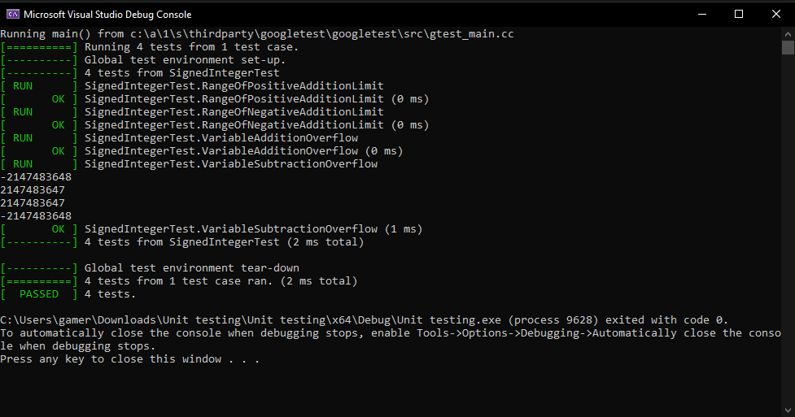
Unit Testing
I will be showing you some basic unit tests for the standard INT32. These tests are made to show the upper and lower limits of the signed integer variable along with the results of an up and lower overflow. Below are the results of those tests and the following slides will show you the setup for each test.

Slide 9
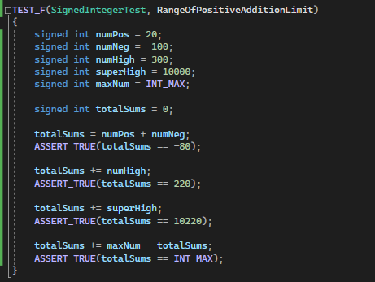
RangeOfPositiveAdditionLimit
This positive addition range test could be further improved by having variables comprised of addition operations present in the calculations. This would ensure multiple operations in one calculation would not cause an overflow.

Slide 10
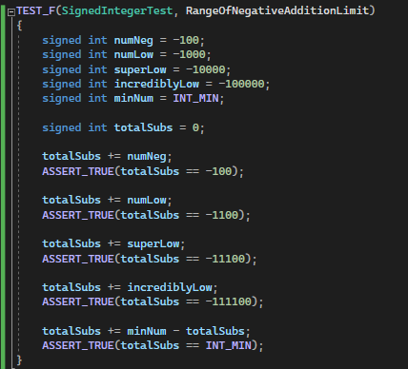
RangeOfNegativeAdditionLimit
Similar to the last test we can push this test further by having numerous subtraction operations in the same calculation.

Slide 11
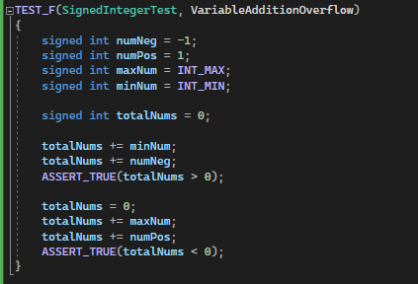
VariableAdditionOverflow
The third test uses addition to push past the established limits in our previous tests. An easy improvement for this test would be to push the limit further than 1 integer over each side.

Slide 12
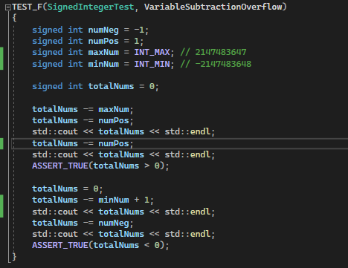
VariableSubtractionOverflow
Our final test handles going over both limits using the subtraction operation. The best improvement for this test would be adding more combinations of both positive and negative integers in the equations. Alternating between the two could yield errors in the right situation.

Slide 13

AUTOMATION SUMMARY

Slide 14
TOOLS
The DevOps pipeline is a systematically planned loop that moves software between stages as the need arises. The cycle takes small or large scale plans and begins by refining them. These ideas are worked on and refined with security policies until it can be built and coded. As the code is written we design and run tests alongside our code to verify its functionality. Once the final inhouse tests are run we then shift over to penetration testing and security setup. With all of this and the software running properly we can now handle log collection and intrusion detection. Should any corruption or manipulation take place we then shut down or rollback the software to prevent further changes. Finally we return our software to a stable state and restart the cycle using the issue as a starting point.
The tools listed in the coding standards present in Green Pace's security policy are all focused on checking for general vulnerabilities, however the tools chosen have specific tests that are able to detect the issues necessary for our standards. These tools are great for checks right after the initial build to see if you left any vulnerabilities. In regards to the previous DevOps pipeline you want to run your tests in two main locations. These tests should be run at the end of the design phase as you build some of your initial variables and calculations. The rest of your vulnerability tests should be run during your verification and testing phase. These tests will consist of ensuring your software doesn't crash, no memory leaks exist, and no exceptions are missed.

Slide 15
RISKS AND BENEFITS
When it comes to issues with acting now or waiting we find waiting to have the most generalized risks. That's not to say that prepping early doesn't have small possible issues. Companies who go through prepping for as many scenarios as possible end up having incredibly complex code. This complexity can leave more vulnerabilities then you'll notice even with the tools discussed in our policy. These preparations can also prove to be fruitless if your developers prep for an issue that may never come up. If your software is heavy on memory extra security layers may just slow down your software. This goes double for software that decides to wait until an issue comes up to prep their security more. Software like this can go through massive data leaks or account theft that could cause permanent issues for the company. The only "benefit" as some companies will look at it is that you will be able to push your software out quicker than if you went through meticulous preparation. These ideas are rather general and could use some improvement to make them a little more viable. Companies that wish to prepare heavily would be advised to research potential attacks for their type of program. The other end of the spectrum will find themselves wanting to do similar research even for the bare minimum of protection. No development team should release code with no security at all unless they are aiming to tank their company's image.

Slide 16
RECOMMENDATIONS
The security policy created for Green Pace is a very generic one at best. The standards chosen to be emphasized in this policy are centered around basic variables and general good coding habits. Standards were chosen with the intent of covering more basic software development projects. Green Pace has a large gap in the way it handles more complex security concerns. Our policy doesn't go over ways to handle malicious inputs, data injections, or even account creation standards. In today's age almost every piece of software involves some manner of authentication to ensure only proper users have access to the software. Even Microsoft office requires users to login now to ensure they actually own the software, whereas in the past if you used their CD to download the software you didn't have to worry about credentials. One of the best improvements that could be added to our existing policy would be standards oriented around preventing malicious user input. In any software that will be handling sensitive information you need ways to regulate the input so users can't push command phrases that will grant them unauthorized access to said sensitive information. Even one improvement could make your software several times safer for any user.

Slide 17
CONCLUSIONS
To finish out this long winded presentation I would like to suggest a couple of standards to adopt to help improve Green Pace's or even your security in the future. A simple rule to add is rule MSC4, never hard code sensitive information. This is incredibly important since hard coded information requires a complete shutdown to edit or move it around the server. This may be ok when the program is small and easy to handle, but this immediately becomes an issue for a system that has multiple users moving in and out. Secondly I would suggest adding in standard INT31 to ensure no data is lost when integer conversions take place. Depending on the software being created you may be doing numerous conversions and you have to ensure you aren't altering data every time. With these two suggestions I think this policy would be well on its way to being professional grade security.

Slide 18
REFERENCES
Admin. (2020). Sei cert C++ coding standard. SEI CERT C++ Coding Standard - SEI CERT C++ Coding Standard - Confluence. Retrieved February 18, 2023, from https://wiki.sei.cmu.edu/confluence/pages/viewpage.action?pageId=88046682
Seacord, R. C. (2013). Secure coding in C and C++. Addison-Wesley.

